Slide 1

Insights into Customer Sentiments: A Comprehensive Analysis of British Airways Reviews
Thandokazi Dlamini Data Scientist

Slide 2
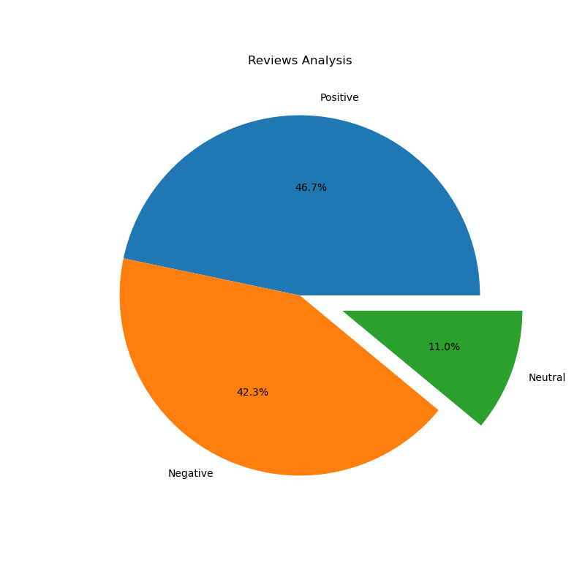

Insights from customer airline reviews
From cleaning the customer airline reviews, these were the findings :
Positive reviews : 467
Negative reviews : 423
Neutral reviews : 110

Slide 3
Insights and Recommendations from British Airways Customer Reviews Analysis
Insights:
Sentiment Distribution: The analysis reveals a diverse range of customer sentiments with 46.7% positive, 42.3% negative, and 11.0% neutral reviews. This suggests that while a significant portion of customers are satisfied, there is a notable fraction that experienced issues with the airline's services.
Key Themes in Reviews: The word cloud visualization indicates the most frequently mentioned terms in the reviews. Common themes include specific aspects such as 'service', 'flight', 'staff', and 'experience'.
Customer Service Focus: Both positive and negative reviews frequently mention staff and service quality, indicating that these are crucial factors in customer satisfaction.
Flight Experience: Terms related to the actual flight experience, such as 'seat', 'class', 'food', and 'entertainment' were prominent, pointing to their impact on overall customer perception.

Slide 4
Insights and Recommendations from British Airways Customer Reviews Analysis
Recommendations:
Enhance Customer Service: Given the significant impact of staff interactions on customer sentiment, investing in staff training and customer service initiatives could lead to an increase in positive customer experiences.
Improve Onboard Comfort: Addressing frequently mentioned issues related to seating comfort, meal quality, and in-flight entertainment could significantly enhance the overall flight experience.
Address Specific Complaints: Detailed analysis of negative reviews can provide actionable insights into specific areas needing improvement, such as check-in processes, luggage handling, and punctuality.
Leverage Positive Feedback: Positive reviews often highlight what the airline is doing right. These aspects should be maintained and further enhanced to ensure continued customer satisfaction.
Regular Monitoring and Response: Implement a system for regular monitoring of customer feedback and timely response to complaints and suggestions to improve service quality and customer satisfaction.

Slide 5
Conclusion
In our comprehensive analysis of customer reviews for British Airways, we have utilized data scraping, cleaning, and advanced sentiment analysis techniques to gain deep insights into customer experiences and perceptions.
Key Takeaways:
Balanced Sentiments: Our findings reveal a balanced distribution of sentiments among British Airways customers, with a slightly higher inclination towards positive reviews. However, the significant presence of negative sentiments highlights areas needing attention.
Customer Experience at the Forefront: The analysis underscored the importance of customer service and onboard experience as pivotal factors influencing customer satisfaction and loyalty.
Data-Driven Decisions: The insights derived from the review data provide a factual basis for decision-making, enabling the airline to target specific areas for improvement and reinforcement.

Slide 6
CONCLUSION
Moving Forward:
Strategic Customer Service Improvements: By focusing on areas where negative sentiments were most pronounced, British Airways can strategize to enhance customer experience, which could potentially convert negative perceptions into positive ones.
Continual Monitoring and Adaptation: It's crucial for the airline to continually monitor customer feedback and adapt its services accordingly. This proactive approach can help in maintaining a high standard of customer satisfaction.
Leveraging Strengths: Capitalizing on the positive aspects highlighted in the reviews can help British Airways in reinforcing its brand reputation and customer loyalty.
Conclusion:
This analysis not only serves as a tool for understanding customer sentiments but also acts as a guide for strategic business improvements. By leveraging the power of data analytics, British Airways can enhance its service offerings, address customer concerns more effectively, and position itself as a responsive and customer-centric airline in a competitive market.

